Slide 1

Risk Prediction
Paidy

Slide 2

A
Agenda
1
Data Quality Check
2
Data Distribution
3
Feature Collinearity
4
Risk Distribution
5
Xgboost Model
6
High-Risk Validate
7
Logistic Regression
8
CNN Model
9
Conclusion

Slide 3
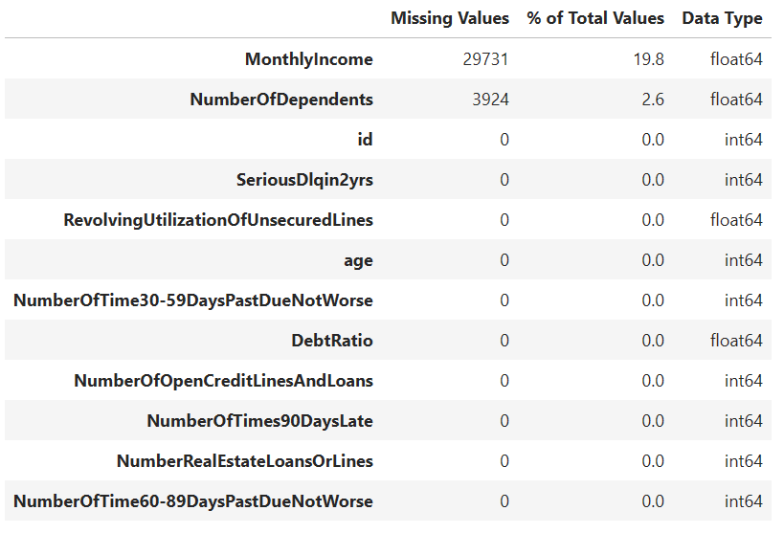
01
Data Quality Check
Train Dataset Missing Rate
Note:
1. There are missing values on the MonthlyIncome and NumberOfDependents fields
2. MonthlyIncome field has a relatively high missing rate compared with NumberOfDependents

Slide 4
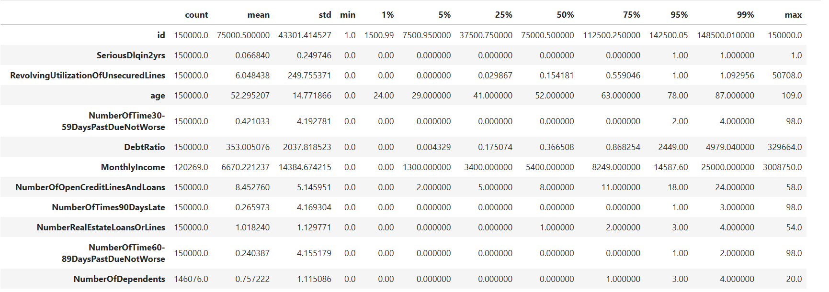
02
Data Distribution
2
1
3
4
Note:
1. Age should not contain data with 0.
2. RevolvingUtilizationOfUnsecuredLines has some extreme values
3. Debt ratio has some outlier data
4. NumberOfDependents has some extreme / unreasonable values

Slide 5
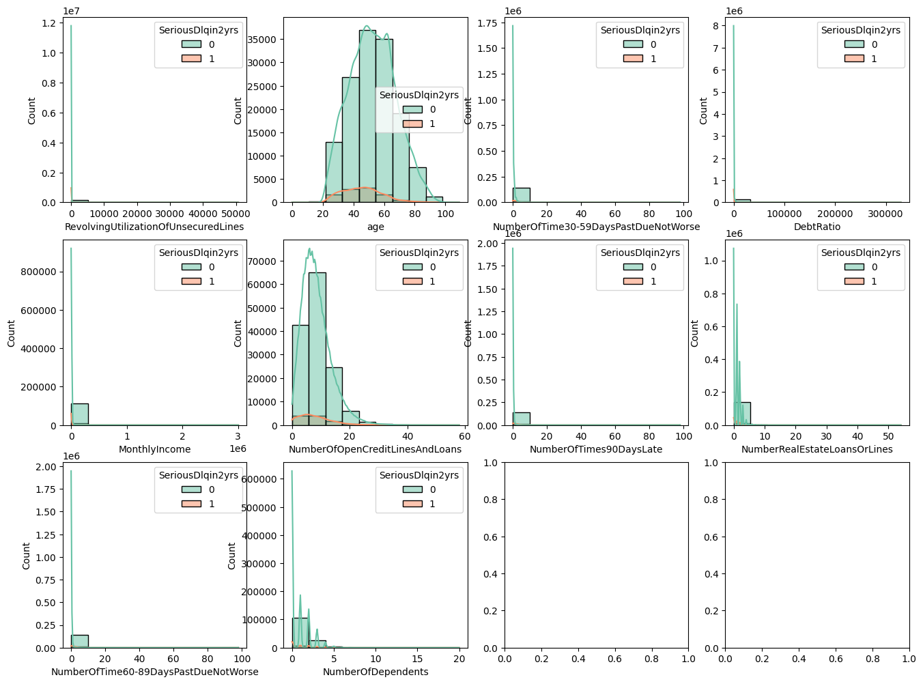
02
Data Distribution
Note:
1. RevolvingUtilizationOfUnsecuredLines is mainly around 0 while there are some extreme values
2. DebtRatio field’s distribution is strange. Most of the values is around 0 while there are some large values.
3. MonthlyIncome and NumberRealEstateLoansOrLines filed has some long-tail values on the right.
1
2
3
3

Slide 6
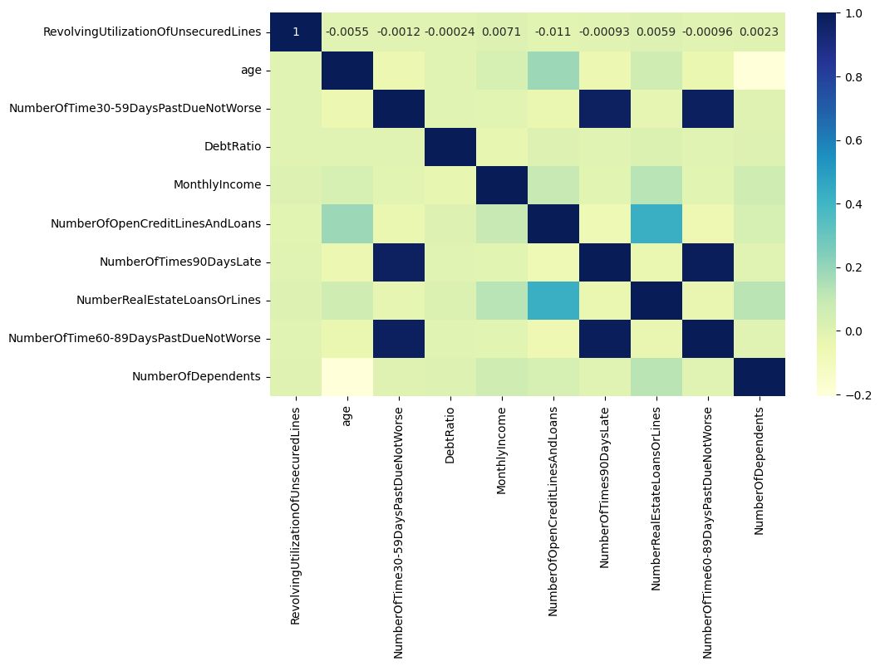
03
Feature Collinearity
Note:
1. NumberOfTime60-89DaysPastDueNotWorse, NumberOfTimes90DaysLate and NumberOfTime60-89DaysPastDueNotWorse has high collinearity (Over 0.9).
2. NumberOfOpenCreditLinesAndLoans and NumberRealEstateLoansOrLines has relatively high relevance (over 0.45)
1
2
1
1

Slide 7
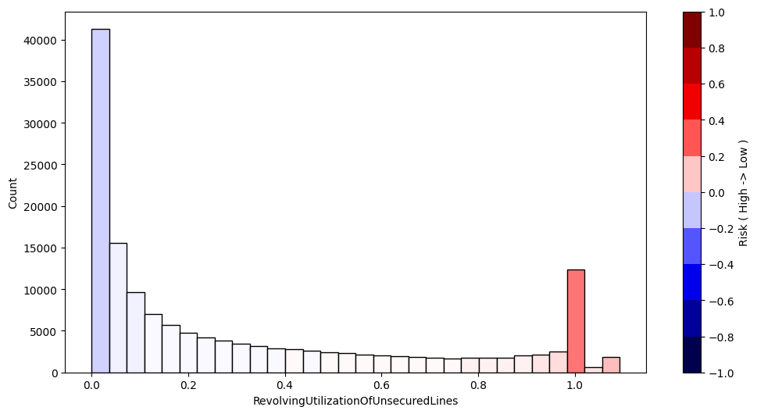
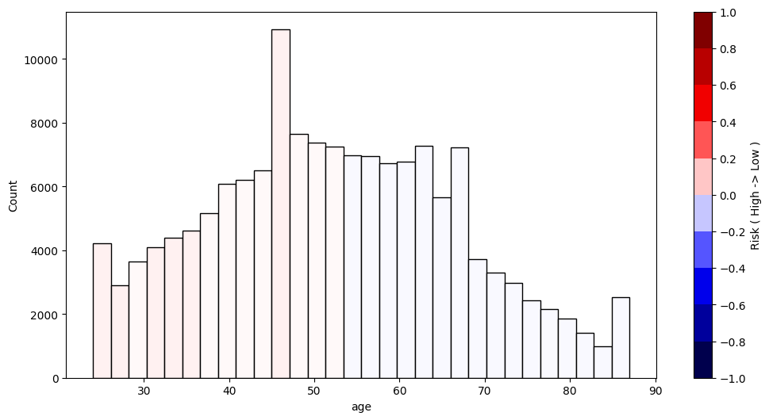
04
Risk Distribution
Note:
1. We checked the bad customer distribution on different features within maximum 30 bins using K-L distance or Cross-Entropy measurement.
2. The red color means high risk while blue color means low risk
3. RevolvingUtilizationOfUnsecuredLines field has some relatively linear relationship with risk. When RevolvingUtilizationOfUnsecuredLines is low, it is low risk, while high RevolvingUtilizationOfUnsecuredLines means high risk
4. Age field is not significant feature compared with RevolvingUtilizationOfUnsecuredLines field. It seems that young age is relatively high compared with old age customers.

Slide 8
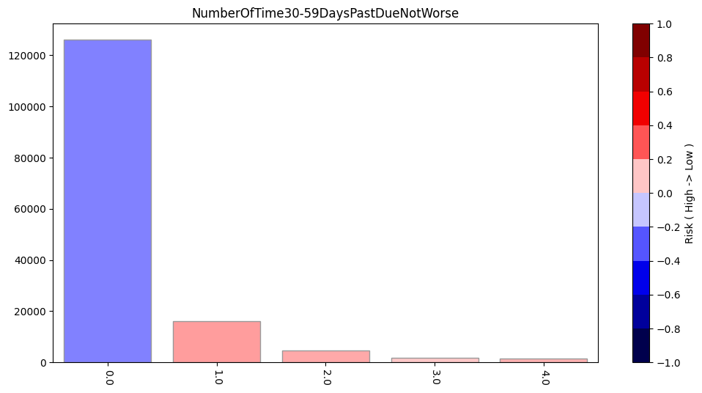
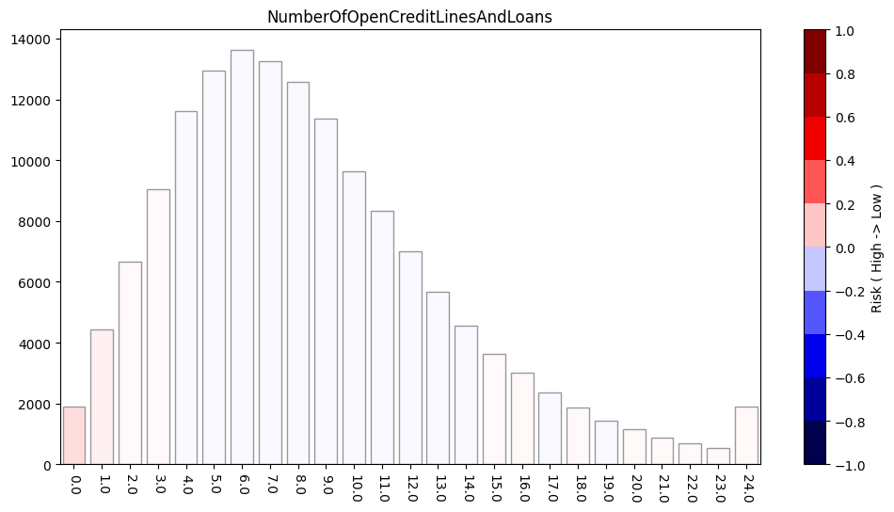
04
Risk Distribution
Note:
1. NumberOfTime30-59DaysPastDueNotWorse field has low risk at 0 value while relatively high when > 1. It is also interesting that risk decreases when NumberOfTime30-59DaysPastDueNotWorse is over 3.
2. NumberOfOpenCreditLinesAndLoans field is relatively high when the value is less than 3 or larger than 15. It is very interesting.

Slide 9
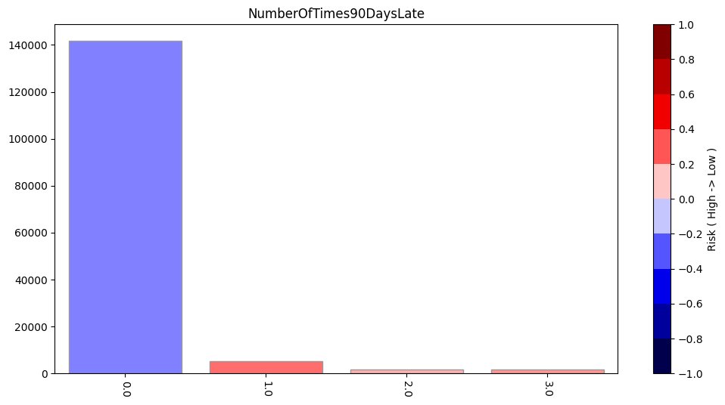
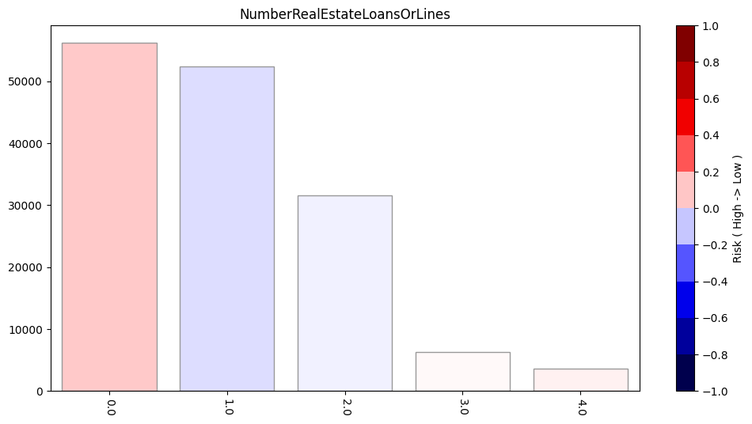
04
Risk Distribution
Note:
1. NumberOfTimes90DaysLate is at highest risk when the value is 1. Similar to NumberOfTime30-59DaysPastDueNotWorse field.
2. NumberRealEstateLoansOrLines field is high risk at 0. The risk is relatively low at 1 or 2, then increase again.

Slide 10
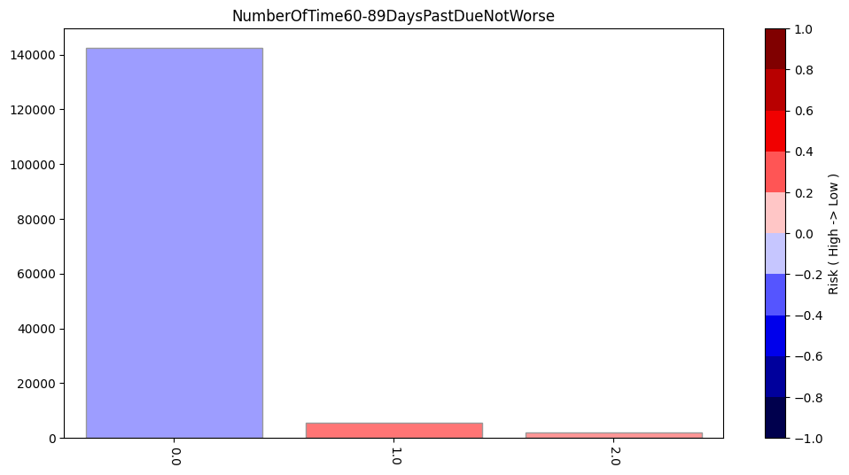
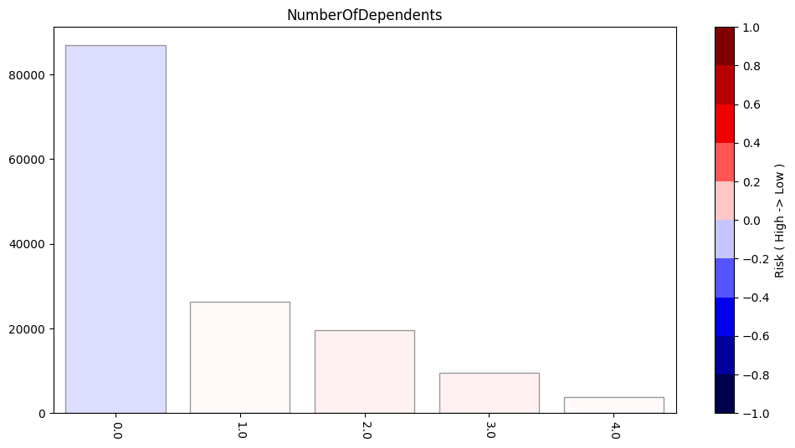
04
Risk Distribution
Note:
1. NumberOfTime60-89DaysPastDueNotWorse field has low risk at 0 while highest at 1. Similar to other 2 field : NumberOfTimes90DaysLate and NumberOfTime30-59DaysPastDueNotWorse
2. NumberOfDependents filed is relatively low at 0 while relatively high when the number increases. The highest point is at 2 / 3.

Slide 11
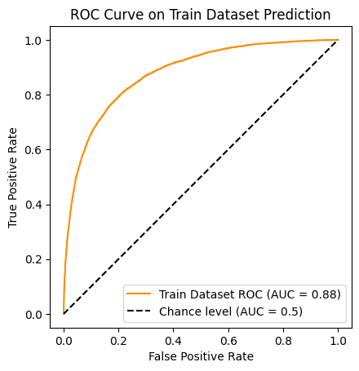
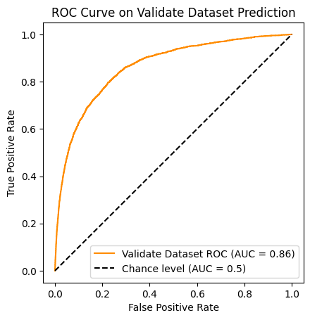
05
Xgboost Model - Train
Note:
The reason why I selected Xgboost model as the main model here is that Xgboost model has the advantages:
1. As one of the most famous ensemble models, it is relatively has better performance compared with single CART tree model.
2. Xgboost model can handle the NAN values.
3. Xgboost model can effectively overcome the overfiting compared with other models.
4. Here we also combined with RandomizedSearchCV module that uses Cross-Validation to overcome overfitting.
5. The performance of the model is quite good with AUC score at 0.88 on Training Dataset and 0.86 on Validate Dataset (30% of the whole Train Dataset.)

Slide 12
06
High-Risk Validate
Note:
We set threshold as 0.5 and select the high-risk customers from Validate dataset. This account for 2.5% of the validate dataset.
The measurement:
Precison = 631 / (631 + 502) = 55.7%
Recall Rate = 631 / (631 + 2287) = 21.6%
True
False
631 | 502
2287 | 41580
Positive
Negative

Slide 13
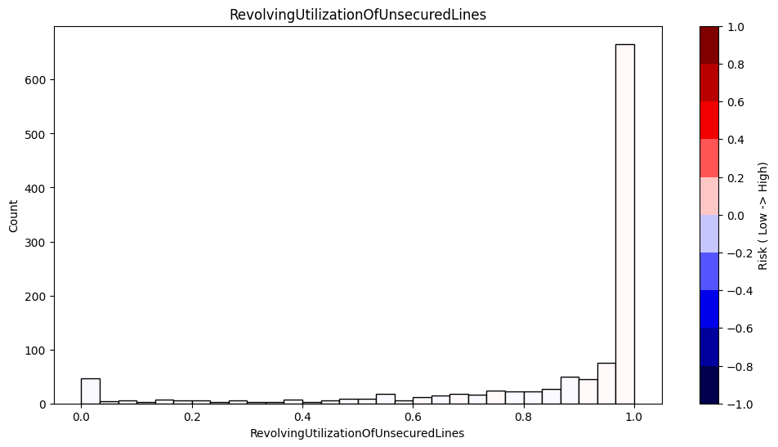
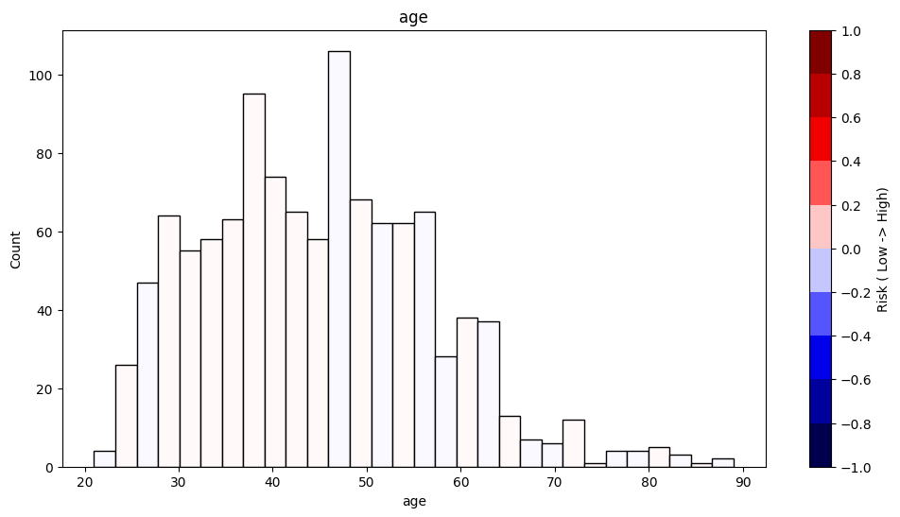
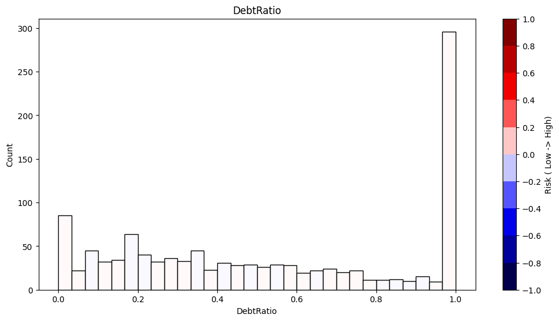
06
High-Risk Validate
Note:
Based on the risk distribution on different features, we can see that the risk distribution is quite uniformly distributed.
This partly prove that our model is working well.

Slide 14
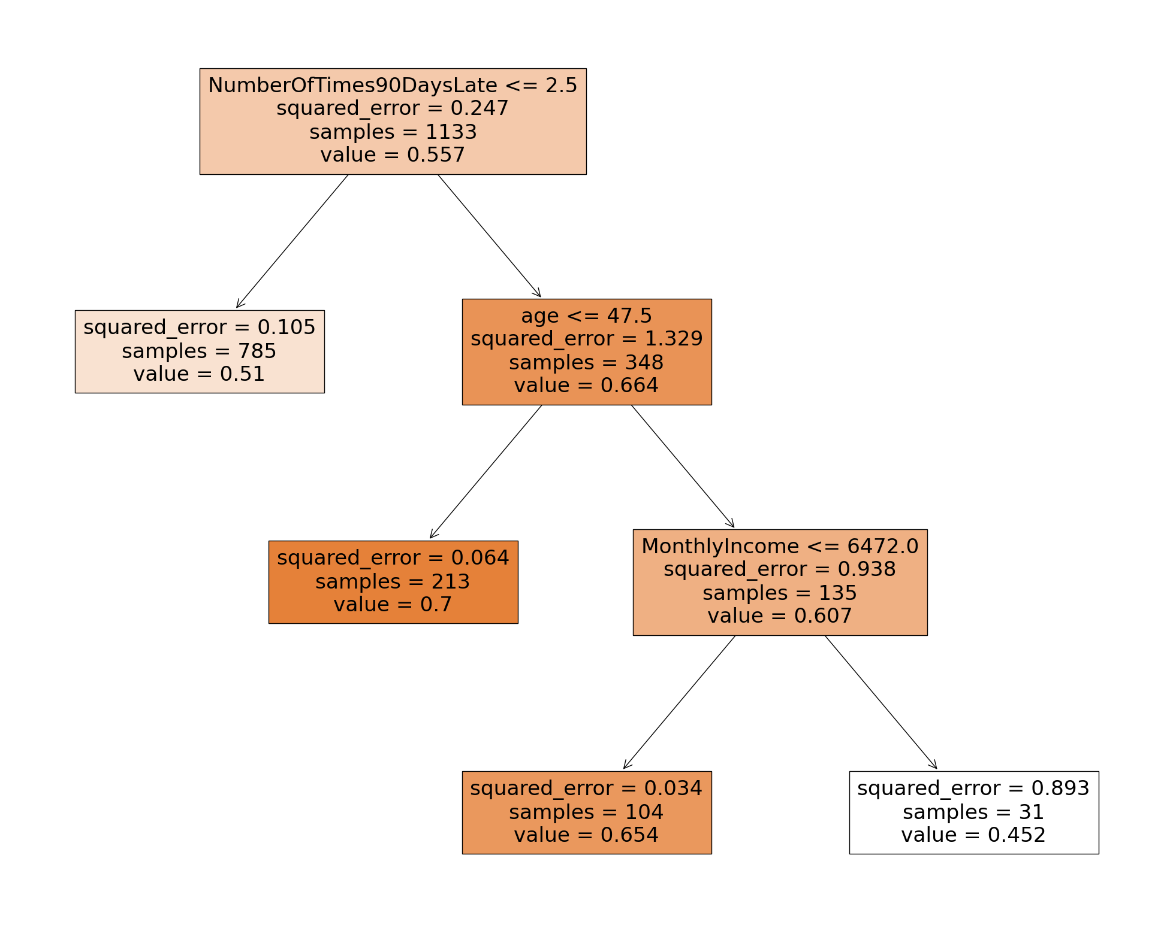
06
High-Risk Validate
Note:
To better refine the result, here we use CART tree to split the current customer pool based on the features.
It shows that NumberOfTimes90DaysLate field is the first factor that spit the customers, then age and MonthlyIncome.
The Highest risk score here is the branch:
(NumberOfTimes90DaysLate > 2.5) & (age <= 47.50)
Precision : 70%

Slide 15
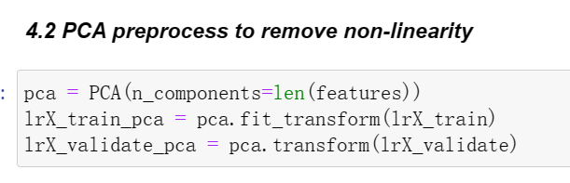
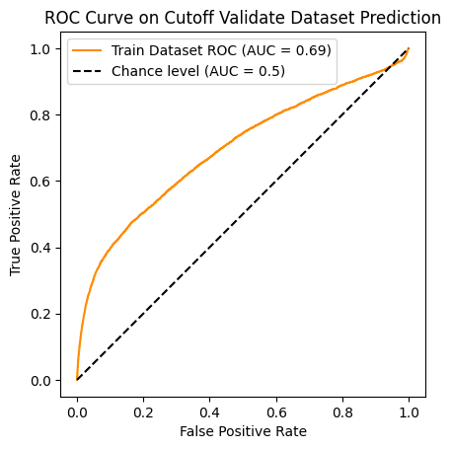
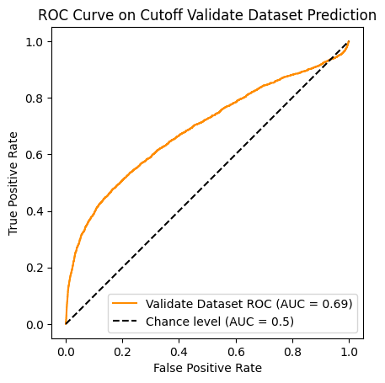
07
Logistic Regression Model
Note:
Since there are some collinearity among the features (as we showed in Part 3), we applied PCA to the data first.
The AUC score is 0.69 for Train Dataset and Validate Dataset.

Slide 16
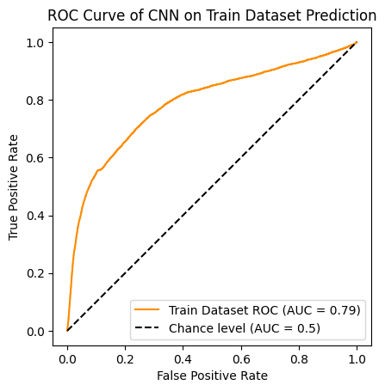
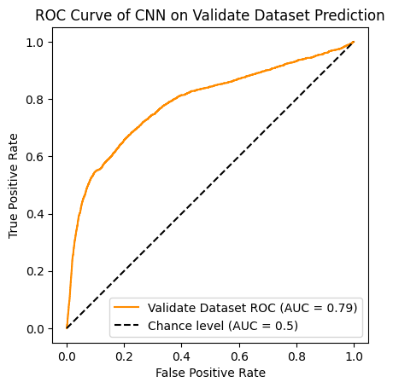
08
CNN Model
Note:
Here we applied CNN model as upgrade compared with Logistic Regression model.
We can treat CNN as emsemble model of multiple Logistic Regression models.
The performance here is 0.79 on both Train and Validate dataset.

Slide 17
09
Conclusion
Note:
In this case, we used Xgboost, Logistic Regression and CNN model to predict the risk score of the customers.
Based on the performance, Xgboost > CNN > Logistic Regression.
As for the features, RevolvingUtilizationOfUnsecuredLines , NumberOfTimes90DaysLate , NumberOfTime60-89DaysPastDueNotWorse, NumberOfTime30-59DaysPastDueNotWorse are the most important features.
If we set a threshold as 0.5 and we can make the result better with some rules extracted from tree models

Slide 18

Thank you
Email: zhang.ai.japan@gmail.com

